Slide 1
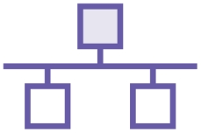
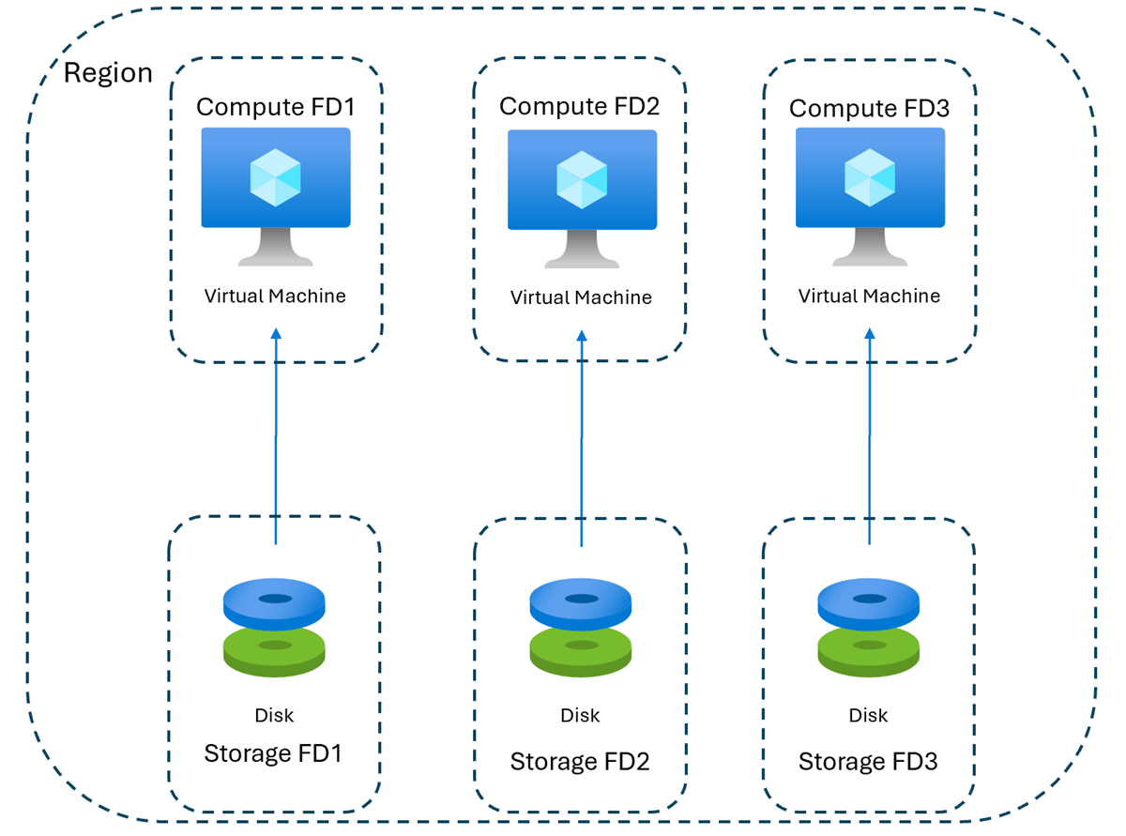
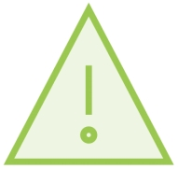
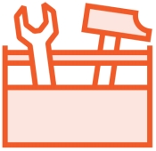
Availability Sets
VMs are placed on nodes in a rack
Failures can occur at node and rack levels
Maintenance is also required on hosts and VMs are not live migrated
Notes:
Availability Sets in Azure are used to ensure high availability for virtual machines (VMs) within a single region.
Fault Domains (FDs)
The diagram shows three Compute Fault Domains (FD1, FD2, FD3), each with a VM and its corresponding Storage Fault Domain.
A Fault Domain represents a group of resources that share a common power source and network switch.
By distributing VMs across multiple fault domains, Azure protects against rack-level failures.
Update Domains
Although not explicitly shown, Availability Sets also distribute VMs across Update Domains.
This ensures that during planned maintenance, only one update domain is rebooted at a time, minimizing downtime.
Failure and Maintenance Considerations
VMs are placed on different physical nodes within a rack.
Failures can occur at both the node and rack level, which is why fault domain separation is critical.
During planned maintenance, VMs in Availability Sets are not live migrated—they are rebooted, but Azure ensures only one update domain is affected at a time.
Availability Sets are ideal for legacy applications or workloads that require 99.95% SLA within a single region.
For higher availability and zone-level redundancy, consider using Availability Zones or Virtual Machine Scale Sets with zone distribution.

Slide 2

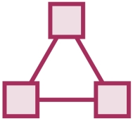
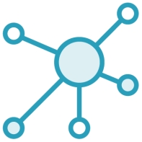
Availability Sets
To ensure availability of services, always deploy minimum 2 instances of any service and place in a unique availability set
This ensures VMs are spread over three fault domains (racks) and five (by default) update domains
Must have minimum 2 VMs to receive SLA of 99.95%
Notes:
Fault Domains (default 3)
When you put VMs in to an availability set, Azure guarantees to spread them across Fault Domains and Update Domains. A Fault Domain (FD) is essentially a rack of servers. It consumes subsystems like network, power, cooling etc. So 2 VMs in the same availability set means Azure will provision them in to 2 different racks so that if say, the network or the power failed, only one rack would be affected.
Update Domains (default 5)
If there is a patch that must be applied to the hypervisor than it will do a rolling update across Update Domains to avoid any downtime to your apps.

Slide 3
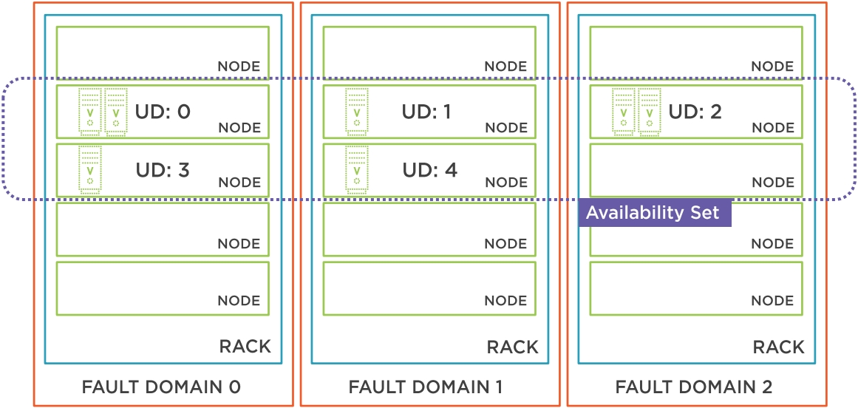
Availability Sets
Notes:
Fault Domains (FDs)
The diagram shows three Fault Domains (FD0, FD1, FD2), each representing a separate rack with its own power and network infrastructure.
Azure ensures that VMs in an Availability Set are spread across these fault domains to protect against rack-level failures.
Update Domains (UDs)
Within each fault domain, VMs are also distributed across Update Domains (e.g., UD0, UD1, UD2, etc.).
Update domains are used during planned maintenance to ensure that not all VMs are rebooted at the same time.
Azure updates one UD at a time, allowing applications to remain available during platform upgrades.
Availability Set Scope
The Availability Set spans across all three fault domains and multiple update domains.
This configuration ensures that:
At least one VM remains available during hardware failures (FD protection).
At least one VM remains available during planned maintenance (UD protection).

Slide 4


Availability zones
Regions are broken up into physically separate AZs
AZs have independent power, cooling and networking
3 AZs are exposed per subscription
VMs spread over AZs receive 99.99% SLA
Each AZ can be thought of as separate fault domain and update domain
Virtual networks span AZs
Notes:
Availability Zones (AZs) in Azure provide high availability and fault isolation within a single region.
What Are Availability Zones?
Each Azure region is divided into physically separate zones, typically three per region.
These zones are labeled AZ1, AZ2, and AZ3 in the diagram.
Each zone has its own power, cooling, and networking, ensuring that a failure in one zone does not affect the others.
Fault and Update Domain Isolation
Each AZ acts as both a fault domain and an update domain.
This means that deploying VMs across multiple AZs protects against both hardware failures and planned maintenance.
High Availability SLA
When you distribute VMs across two or more AZs, Azure provides a 99.99% SLA for VM uptime.
This is higher than the 99.95% SLA offered by Availability Sets, making AZs the preferred choice for mission-critical workloads.
Virtual Network Integration
A single Virtual Network (VNet) can span all AZs within a region.
This allows seamless communication between resources in different zones without needing peering or additional configuration.
Use Zone-redundant services like Azure SQL Database, Azure Kubernetes Service (AKS), and Azure Load Balancer to simplify high availability.
For even greater resilience, combine AZs with geo-redundant services across multiple regions.

Slide 5
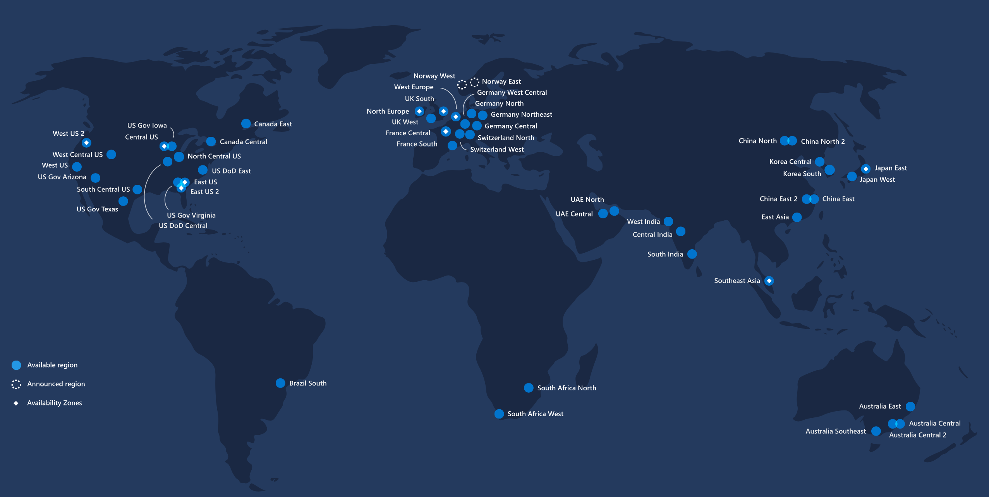
Regions
60+ regions, 140 countries
Notes:
This map highlights Microsoft Azure's global infrastructure, which now includes over 60 announced regions—more than any other cloud provider.
Azure operates 93 availability zones across 33 active regions, ensuring high availability, fault tolerance, and low-latency access for customers worldwide.
Regions such as West US, UK South, India South, and Japan East are among the most active and strategically important.
This global presence supports compliance with local data regulations and enables customers to deploy resilient applications closer to their users.
Azure continues to expand rapidly, with new regions being announced regularly to meet growing demand.

Slide 6
Scale sets
Enables large scale deployment of VMs from single gold image with automatic configuration
Supports auto-scale based on metrics and schedules
Scale sets can be updated without taking down the entire set
54 regions, 140 countries
Notes:
Azure Virtual Machine Scale Sets allow us to deploy and manage a group of identical, load-balanced VMs at scale.
They use a single 'gold image' to ensure consistency across all instances, and support automatic configuration during deployment.
Scale sets can automatically increase or decrease the number of VM instances based on real-time metrics like CPU usage or on predefined schedules—this ensures both performance and cost-efficiency.
One of the key advantages is that updates can be rolled out to the scale set without taking the entire service offline, supporting high availability.
As shown in the diagram, scale sets integrate with other Azure services like load balancers, virtual networks, and storage accounts, all within a defined resource group and subscription.
This architecture is ideal for scenarios like large-scale web applications, microservices, and compute-intensive workloads.

Slide 7
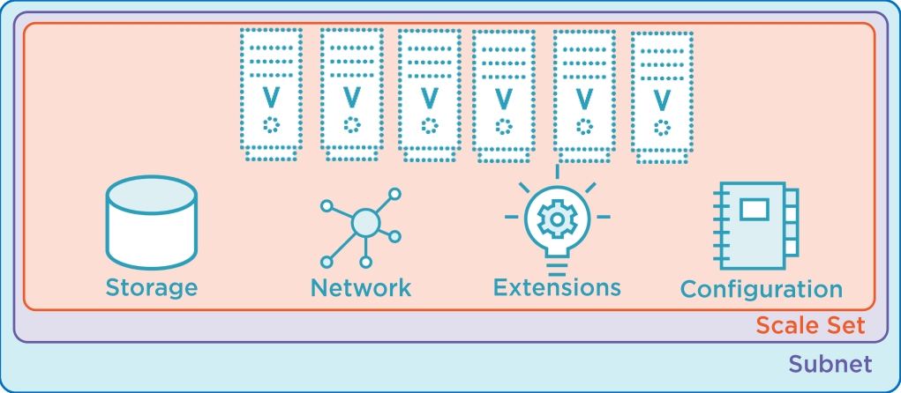
Scale sets
Azure VM Scale Sets enable the entire deployment to be managed in a simple fashion
Enable rollout of updates without taking down the entire service.
Notes:
Azure VM Scale Sets simplify the management of large-scale VM deployments by treating the entire set as a single resource.
They allow updates to be rolled out across the set without requiring downtime, which is critical for maintaining service availability.
The diagram illustrates how storage, networking, extensions, and configuration are centrally managed within the scale set.
Each VM instance in the scale set is part of a subnet, ensuring secure and scalable network integration.
This architecture is ideal for applications that need to scale dynamically while maintaining consistent configuration and high availability.

Slide 8

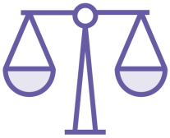
Scale sets Limitations
1000 VMs per Scale Set maximum and use with Azure Standard Load Balancer for matching scale
2000 Scale Sets per region per subscription
Notes:
Maximum VMs per Scale Set:
1,000 VMs per scale set when using platform images or custom images from Azure Compute Gallery 1
.
600 VMs per scale set when using custom managed images 2
.
Maximum Scale Sets per Region per Subscription:
Still 2,000 scale sets per region per subscription
These limits apply to Uniform orchestration mode. Azure also supports Flexible orchestration, which allows mixing VM types and using Spot VMs, but the 1,000 VM limit still applies for high availability scenarios.
https://learn.microsoft.com/en-us/azure/virtual-machine-scale-sets/overview

Slide 9
Auto-scaling Scale Sets
Scheduled
Scale Sets support many types of scale
On a schedule both specific day and recurrence (enables scaling ahead of the load increase)
Based on resource metrics
Can combine (schedule rules take precedence over metric rules)
Metric-Based
Notes:
Azure VM Scale Sets support multiple auto-scaling strategies to ensure optimal performance and cost-efficiency.
Scheduled scaling allows you to define scale-out or scale-in actions based on specific dates, times, or recurring patterns. This is particularly useful for predictable workloads, such as business hours or seasonal traffic spikes.
Metric-based scaling dynamically adjusts the number of VM instances based on real-time performance indicators like CPU utilization, memory usage, disk I/O, or custom Azure Monitor metrics.
These two methods can be combined. When both are configured, scheduled rules take precedence over metric-based rules. This ensures that planned events override reactive scaling logic.
Advanced configurations can include cooldown periods, instance limits, and graceful shutdowns to avoid flapping and ensure smooth transitions.
Auto-scaling is managed through Azure Monitor autoscale settings, which can be configured via the portal, CLI, PowerShell, or ARM templates.
For mission-critical applications, it's recommended to use proactive scaling with predictive analytics and horizontal pod autoscaling if integrated with AKS (Azure Kubernetes Service).

Slide 10
Pop quiz:
You need high availability in a single region and want to support 200 instances in a scale set. Which option should you choose?
A. Regional scale set (non-zonal) without placement groups B. Zonal scale set with true Availability Zones C. Regional scale set with placement groups D. Single VM in an Availability Set

Slide 11
Pop quiz:
You need high availability in a single region and want to support 200 instances in a scale set. Which option should you choose?
A. Regional scale set (non-zonal) without placement groups B. Zonal scale set with true Availability Zones C. Regional scale set with placement groups D. Single VM in an Availability Set
Notes:
A regional VMSS uses placement groups to provide multi-fault-domain redundancy and supports > 100 VMs; beyond thresholds, it auto-stripes across additional placement groups

